Slide 1
Body Systems
Section III:

Slide 2
List of Systems
Core Systems:
Skeletal system
Bones, joints, cartilage
Muscular system
Muscles, tendons, ligaments
Cardiovascular (circulatory) system
Heart, blood, and blood vessels
Lymphatic system*
Gastrointestinal (digestive) system
Intestines, digestive organs
Respiratory system
Pharynx, larynx, trachea, lungs
Nervous system
Brain, spinal cord, peripheral nerves
Ancillary Systems:
Integumentary system
Skin, hair, nails, glands
Reproductive system
Male and female organs
Urinary system
Kidney, ureter, urethra, bladder
Excretory system*
Sensory system
Eye, ear, nose, mouth, skin
Endocrine system
Glands
Immune System

Slide 3
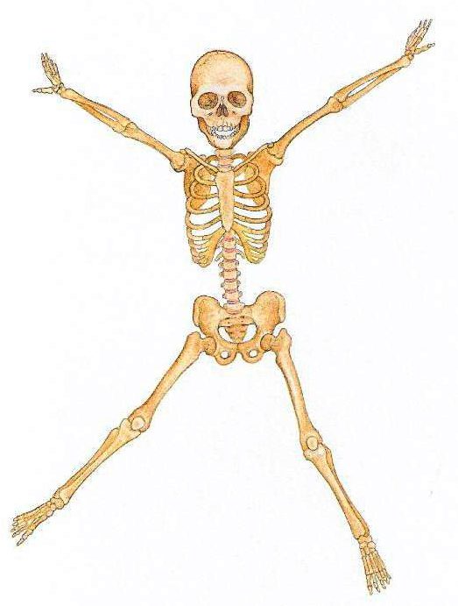
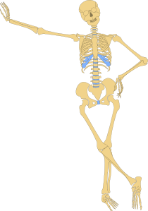
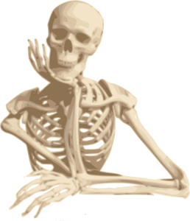
Skeletal System: ‘Dem Bones

Slide 4
Skeletal System
206 bones, including joints and cartilage
Axial skeleton (80)– skull, spinal column, ribs, sternum
Appendicular skeleton (126) – shoulders, pelvis, arms, legs, hands, feet
Protect internal tissue and organs
Stabilize and support the body
Produce red blood cells
Store mineral salts, calcium, phosphorus
Provide surfaces for muscles, tendons, ligaments attachments. Enables movement

Slide 5
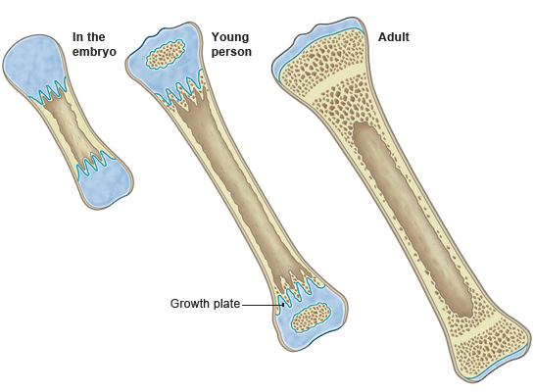
More about Bones
Bone Shapes:
Long bones
Legs, arms
Short bones
Wrists, ankles
Flat bones
Sternum, scapula, cranium
Irregular bones
Vertebrae, hips
Bone Growth:
Controlled by Pituitary Gland
Osteoblasts: new bone cells, created by ossification
Osteocytes: mature bone cells
Osteoclasts: destroy old cells, process called Resorption
Red bone marrow
Growth plates-epiphyseal line
Bone Tissues:
Compact/Osseous: hard, dense; hard shell on outside
Spongy/Cancellous: soft with spaces

Slide 6
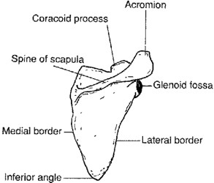
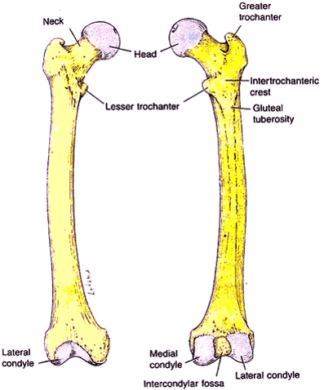
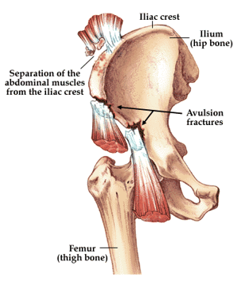
Bone Markings and Processes
Bone Head
Bone Neck
Trochanter: below neck of femur
Condyle: knuckle-like projection
Crest: border or ridge
Spine: sharp projection
Sulcus/Fissure: groove or depression
Sinus/Foramen: opening
Fossa: concave depression
Tuberosity: elevated, rounded area

Slide 7
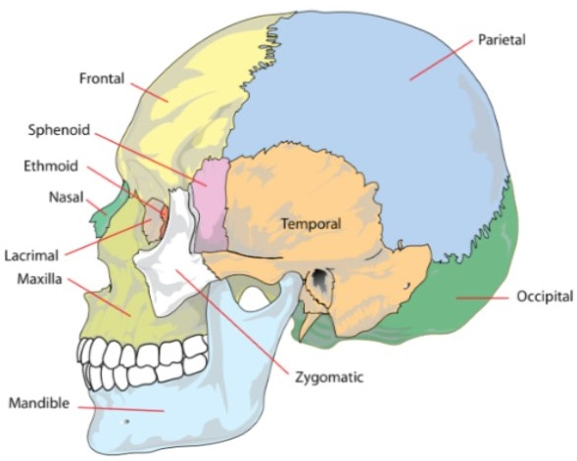
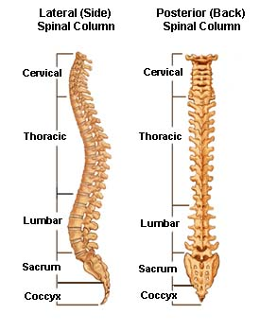
Axial Skeleton: Skull and Spine

Slide 8
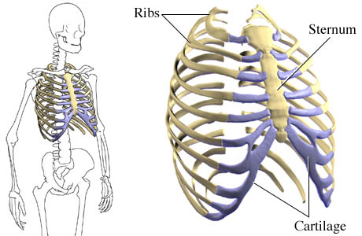
Axial Skeleton: Sternum and Ribs
Attached to clavicles (collarbones)

Slide 9
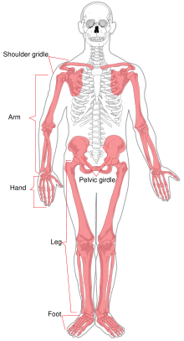
Appendicular Skeleton
(126 Bones)

Slide 10
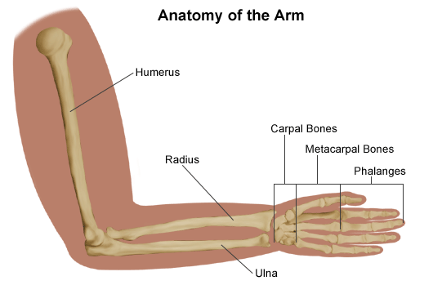
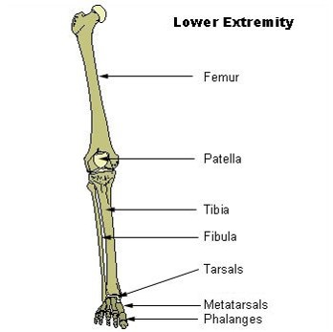
Arms and Legs
Arm Bones:
Upper Arm: Humerus
Lower Arm:
Radius (attaches to thumb)
Ulna (attaches to pinkie)
Leg Bones:
Thighbone: Femur
Kneecap: Patella
Lower Leg:
Tibia/Shin: attaches to inside ankle
Fibula: attaches to outside ankle

Slide 11
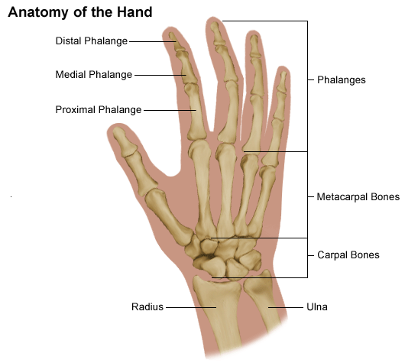
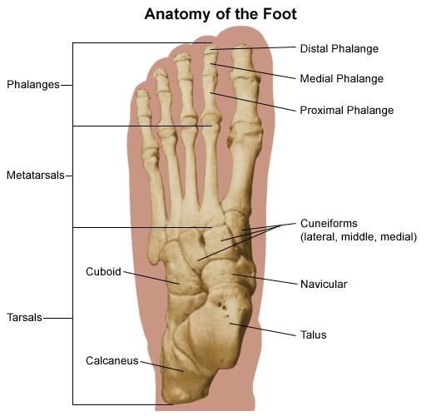
Hands and Feet

Slide 12
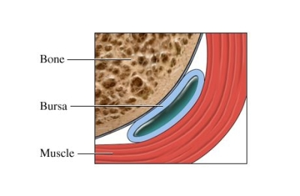
Joints
Fibrous Joint or Sutures: immoveable joints
Skull, Pelvis
Cartilage or Symphysis: slightly moveable joint
Vertebrae, Pubis
Synovial or Diarthrosis: freely moveable joint
Shoulder
Synovial Joints: articular capsule
Synovial membrane contains synovial fluid
Bursa: small sacs with synovial fluid
In all classes of joints to cushion friction points

Slide 13
Roots & Abbreviations
Root Word | Definition
Blast | Embryonic Stage
Calci, calco | Calcium
Carpo | Wrist
Clast | To Break
Costo | Ribs
Cranio | Skull, Cranium
Geno | To Produce
Kyph | Humpback
Lordo | Swayback
Malacia | Softening
Olecran | Elbow
Osteo | Bone
Physis | Growing
Porosis | Porous
Sciolio | Crooked, Bent
Steno | Short, Narrowed
Abbreviation | Definition
C1, C2, C3… | Cervical Vertebrae
DEXA | Dual Energy X-Ray Absorptiometry
DIP | Distal Interphalangeal
Fx | Fracture
L1, L2, L3 | Lumbar Vertebrae
LLE | Left Lower Extremity
LUE | Left Upper Extremity
RLE | Right Lower Extremity
RUE | Right Upper Extremity
S1 | Sacrum
THA | Total Hip Arthroplasty
THR | Total Hip Replacement
TKA | Total Knee Arthroplasty
TKR | Total Knee Replacement
TMJ | Temporomandibular Joint

Slide 14
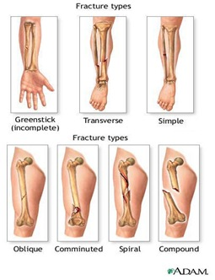
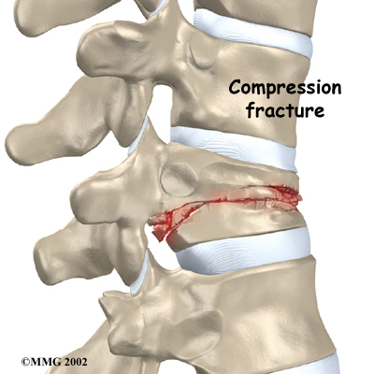
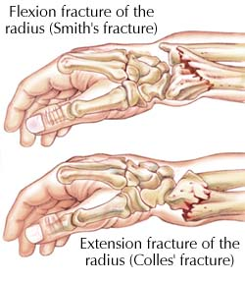
Pathologies
Disease Name | Definition
Osteoporosis | Porous bones
Osteomalacia | Soft bones
Osteomyelitis | Infection in bone
Ewing’s Sarcoma | Malignant Tumor in Children
Osteogenic Sarcoma | Tumor from Bone
Osteochondroma | Benign Bone Tumor
Paget’s Disease | Excessive Bone Destruction
Spinal Stenosis | Narrowing of Spinal Canal
Clubfoot | Foot Turned Inward
Spine Curvature: Kyphosis Lordosis Scoliosis | Humpback Swayback Sideways Curve
Fractures

Slide 15
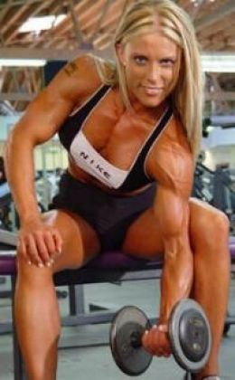
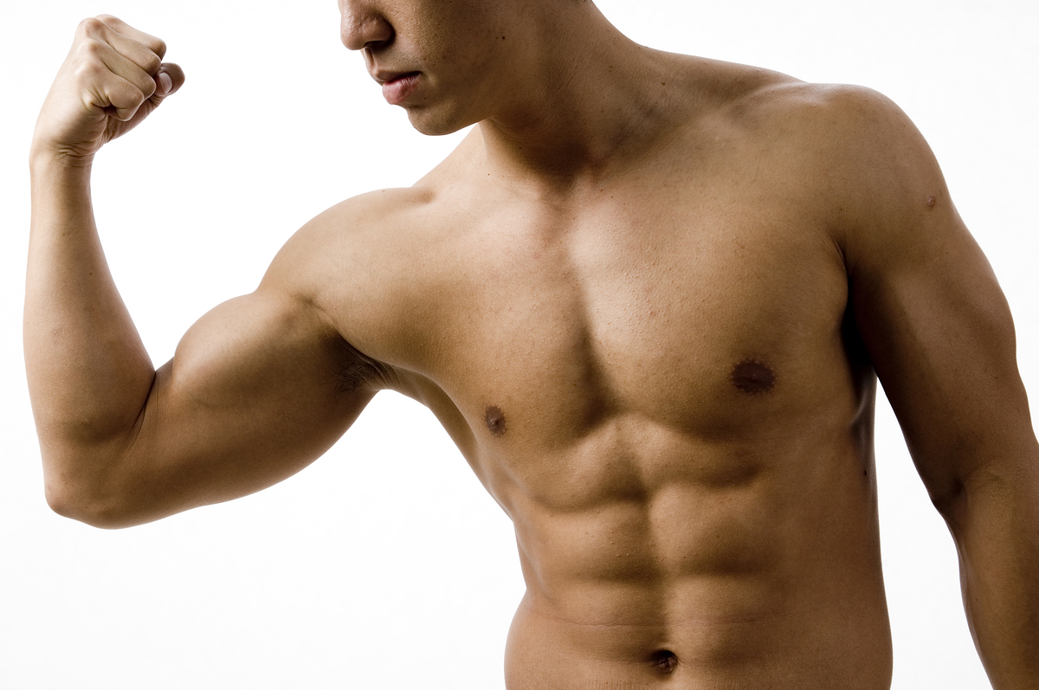
Muscular System

Slide 16
How Many Muscles?
200 muscles that might get discussed in a gym – glutes, pecs, delts, lats, traps, biceps, triceps, hams, quads, etc.
100 more muscles that are pretty obscure, but any self-respecting massage therapist still knows about them
400 more muscles that are really obscure, but various specialists know about them, and a handful of them are of special interest
PLUS:
several million hair-raising muscles
several billion smooth muscles cells blended together
exactly 1 heart muscle
So I’m going to go with a grand total of approximately 50,100,000,701 muscles, accurate to within 99%.

Slide 17
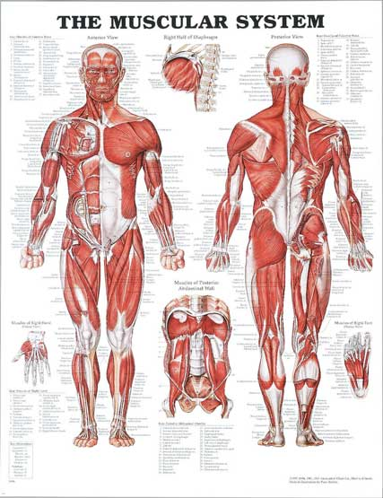
Muscular System
3 kinds of muscles:
Skeletal muscles
Attached to skeleton
Voluntary
Generate body heat
Cardiac muscle:
Involuntary
Visceral muscles:
Involuntary
Smooth muscle tissue
Found in body organs
Lines abdominal organs

Slide 18
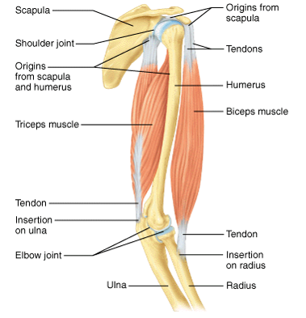
More about Muscles
Composition:
Fibers
Groups of muscle cells
Long and slender
Held together by connective tissue into bundles
Fascia
Enclose bundles of muscle fibers
Fibrous membrane sheath
Function:
Often work in pairs
Prime Mover: contracts
Antagonist: relaxes
Flexors and Extensors
Opposing action
Stimulated by nervous system
Motor impulses from central nervous system
Neuromuscular junction
Muscle Origin
Point where it attaches to a bone; tends to be proximal; larger end.
Muscle Insertion
The opposite point to the origin; tends to be more distal; smaller end

Slide 19
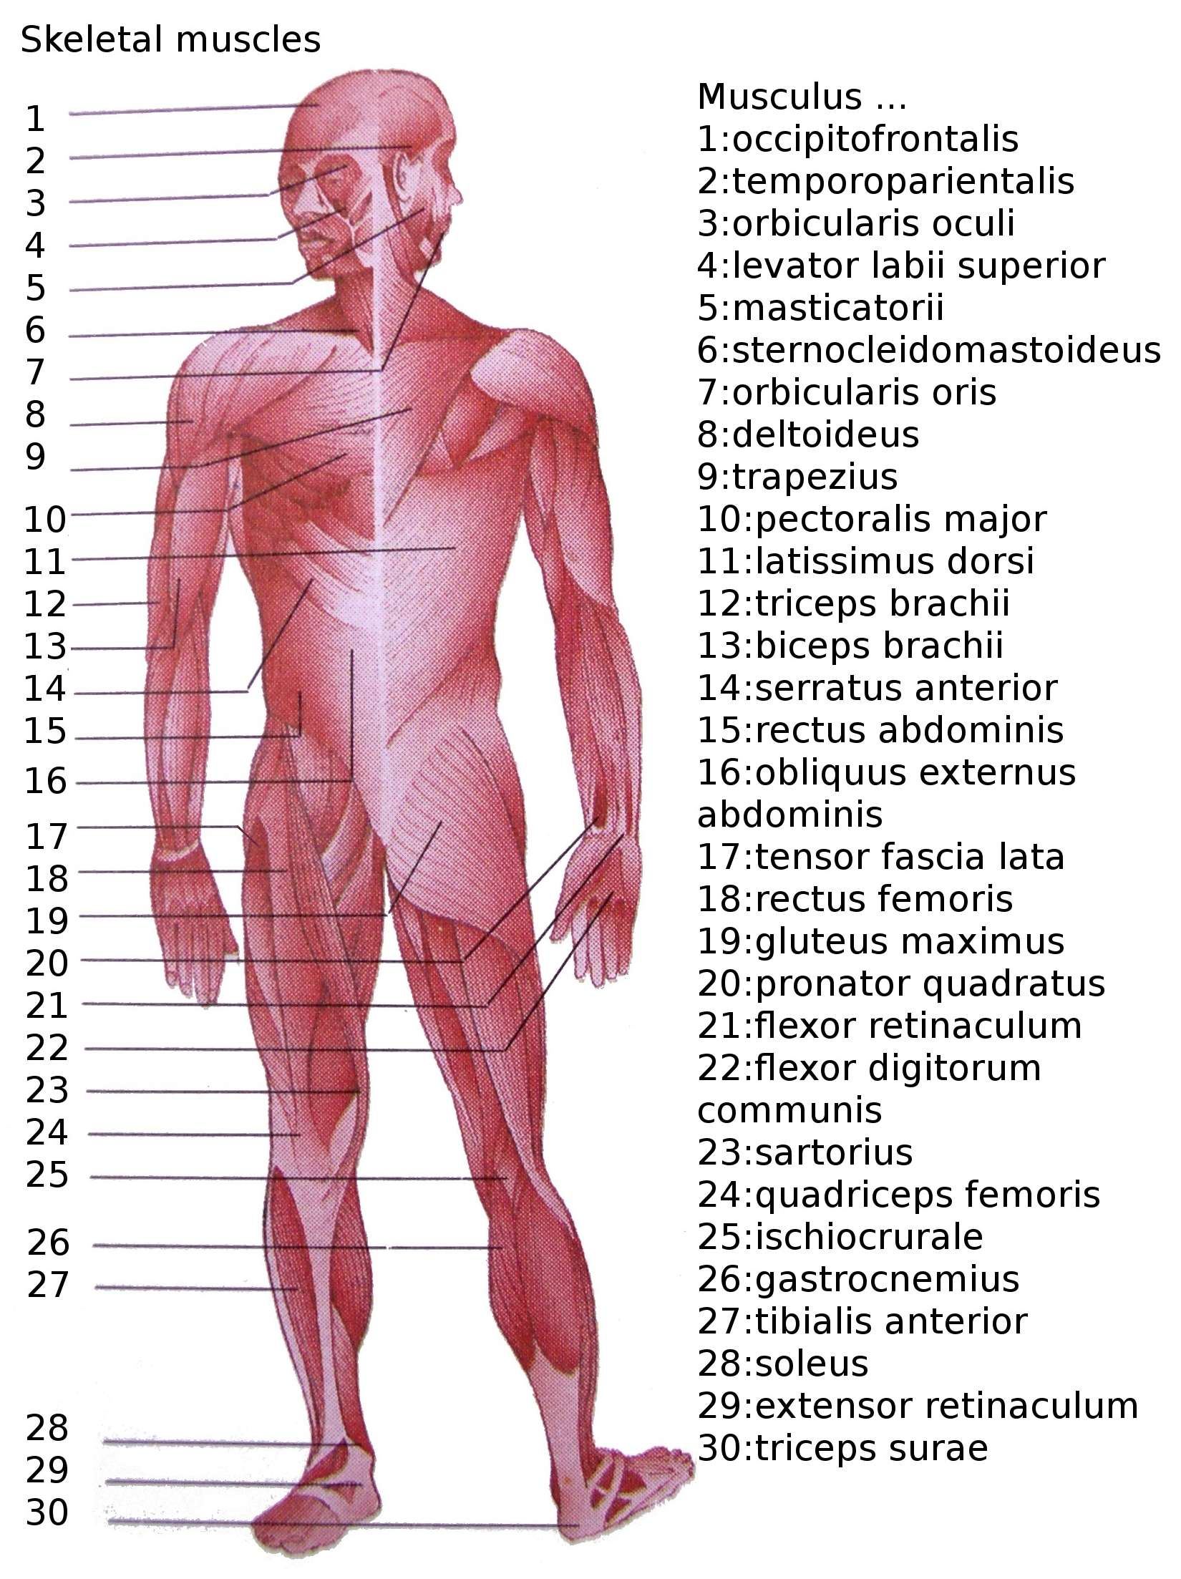
Skeletal Muscles

Slide 20
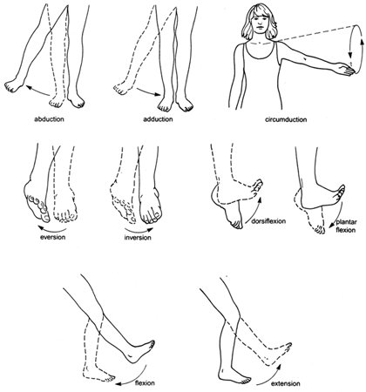
Muscle Movement
Abduction: away from the midline of the body.
Adduction: towards the middle of the body.
Circumduction: circle.
Extension: straightening of a joint.
Flexion: bending a joint
Rotation: movement around the axis of a bone or body part.

Slide 21
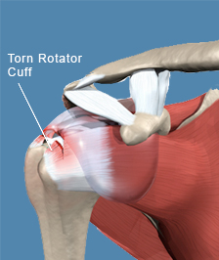
Muscular System - Words
Root Word | Definition
Arthro | Joint
Bucco | Cheek
Fascio | Fibrous Material
Fibro | Fiber
Myo, Myoso | Muscle
Pectoro | Chest
Teno | Tendon
Torso, Trunk | Main Part of Body
Troph | Development
Viscero | Muscles of Internal Organs
Pathologies
Atrophy
Muscular Dystrophy
Arthralgia
Polymyositis
Strain
Sprain
Tendonitis
Rotator Cuff Tear
Arthritis
Bunion
Ganglion
Gout
Lyme Disease
Fibromyalgia
Abbreviation | Definition
IM | Intramuscular
MD | Muscular Dystrophy
DTR | Deep Tendon Response
EMG | Electromyography

Slide 22
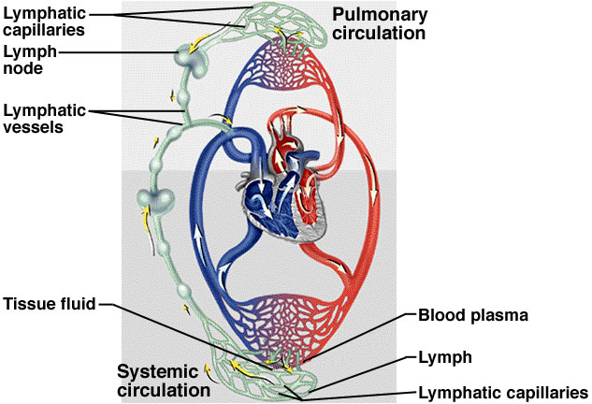
Circulatory System
Cardiovascular system
Lymphatic system

Slide 23
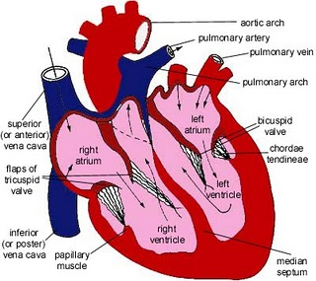
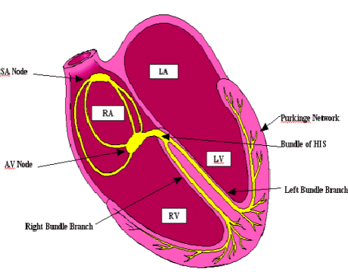
Heart Structure and Electrical System

Slide 24
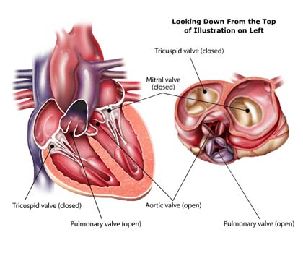
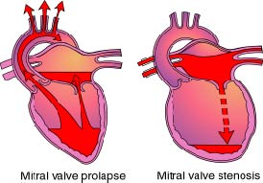
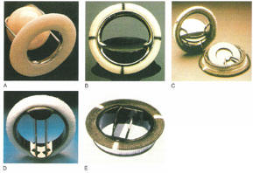
Heart Valves
Leaflets and Chordae

Slide 25
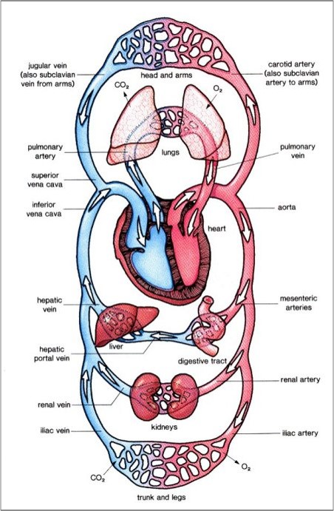
Cardiovascular System

Slide 26
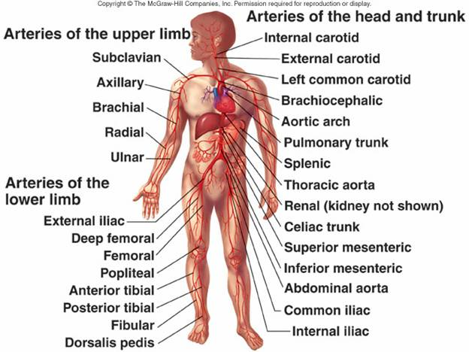
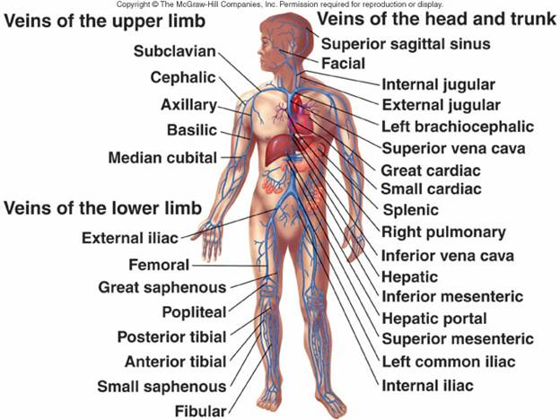
Arteries and Veins

Slide 27
Cardiac Cycle: One Heartbeat
2 alternating phases:
Systole, contraction, forces blood out of heart
Diastole, relaxation, allows heart to fill with blood
Heart beats every second
Rests only 0.4 seconds between beats.
Tachycardia – too fast
Bradycardia – too slow
Blood pressure:
Systolic pressure, during systole
Diastolic pressure during diastole
Measured with:
Sphygmomanometer
Stethoscope
Recorded as fraction:
Systole on top, highest
Diastole on bottom, lowest
Normal is 120/80
Hypertension above 135/85
Hypotension – below normal

Slide 28
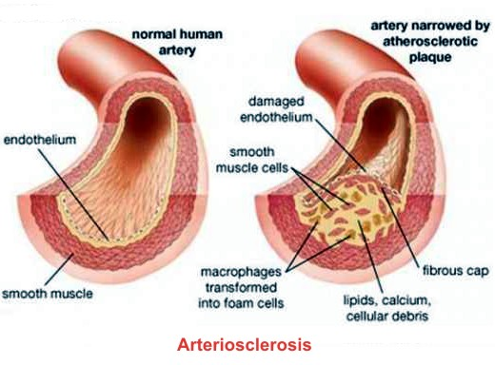
Cardiovascular System Words
Root Word | Definition
Aneurysm | Swelling, Balloon
Angio | Vessel
Arterio | Artery
Athero | Fatty
Cardio, Corono | Heart
Ventriculo | Ventricle
Pathologies
Arteriosclerosis | Coronary Artery Disease
Raynaud’s Phenomenon | Endocarditis
Thrombophlebitis | Mitral Valve Prolapse
Sudden Death Syndrome | Myocardial Infarction
Varicose Veins | Myocarditis
Tamponade | Pericarditis
Angina | Rheumatic Fever
Cardiomyopathy | Heart Block
Congestive Heart Failure | Congenital Heart Disease: Patent Ductus Arteriosus Tetralogy of Fallot Transposition of Great Vessels

Slide 29
More Cardiovascular System Words
Signs & Symptoms
Anorexia, Anxiety
Bradycardia: Pulse less than 60
Tachycardia: Pulse over 100
Chest, Arm, or Jaw Pain
Cyanosis: Blue Skin Color
Dyspnea: Shortness of Breath
Edema: Swelling
Fatigue, Weakness
Nausea, Vomiting
Pallor: Pale Skin Color
Palpitation: Rapid, Throbbing Pulsation
Sweat
Headache
Abbreviation (cont’d) | Definition
AMI | Acute Myocardial Infarction
BBB | Bundle Branch Block
BP | Blood Pressure
CABG | Coronary Artery Bypass Graft
CAD | Coronary Artery Disease
CATH | Catheter
CC | Cardiac Catheterization
CCU | Coronary/Cardiac Care Unit
CHD/F | Congestive Heart Disease/Failure
CPR | Cardiopulmonary Resuscitation
CT/CAT | Computerized (Axial) Tomography
DOE | Dyspnea on Exertion
DVT | Deep Vein Thrombosis
ECG/EKG | Electrocardiogram
ECHO | Echocardiogram
MRI | Magnetic Resonance Imaging
MVP | Mitral Valve Prolapse
ICD | Implantable Cardioverter Defibrillator
PDA | Patent Ductus Arteriosus
PET | Positron Emission Tomography
Abbreviation | Definition
A/V-Fib | Atrial/Ventricular Fibrillation
AS | Aortic Stenosis
AV | Arterioventricular
ASD | Atrial Septal Defect

Slide 30
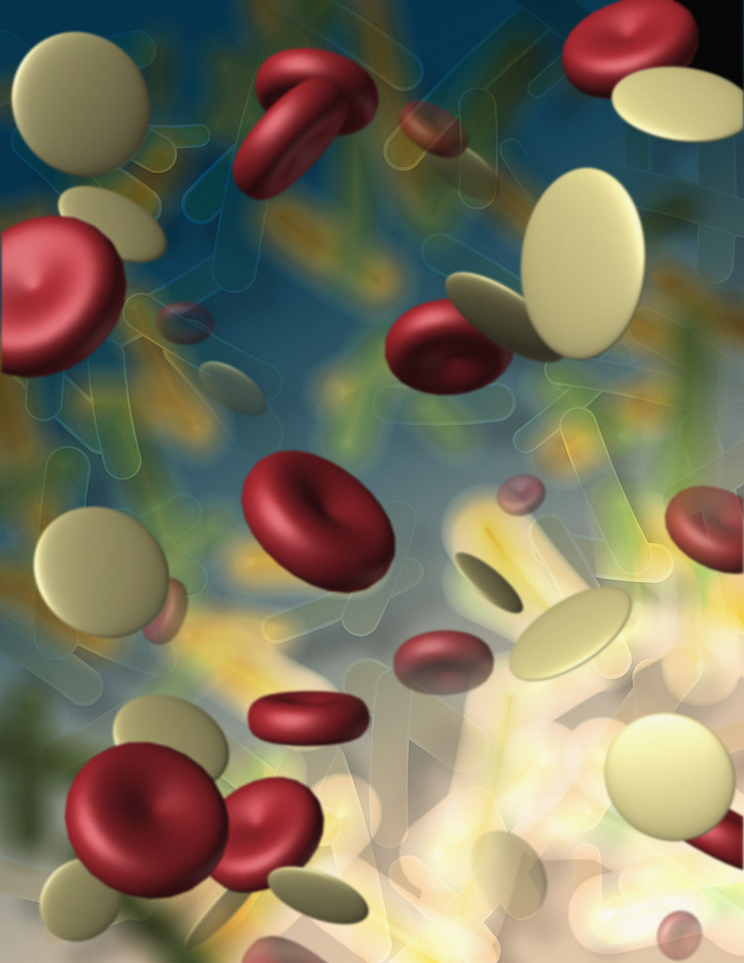
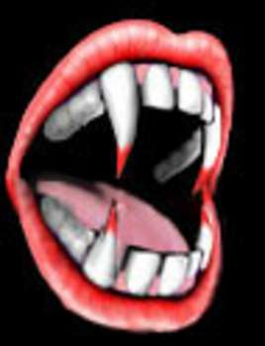
Blood, Immune, & Lymphatic Systems

Slide 31
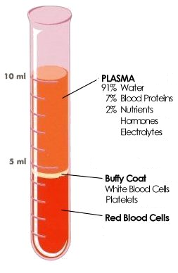
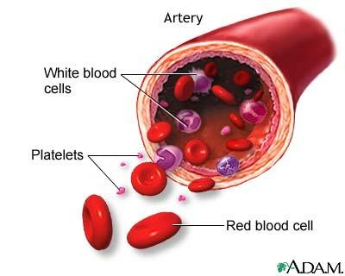
Blood
Functions:
Transportation
Gases, nutrients,
wastes, hormones
Regulation
Fluid balance,
pH, heat
Protection
Disease
Blood loss - clotting

Slide 32
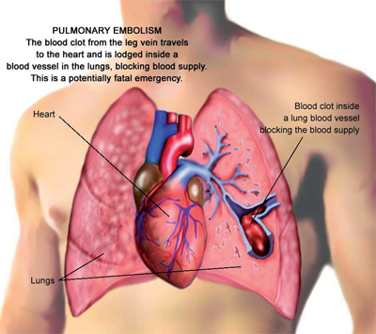
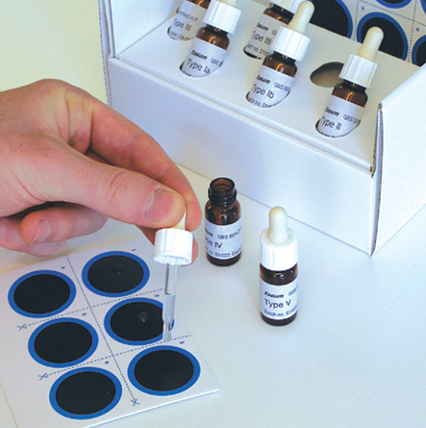
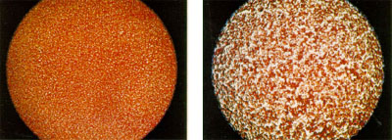
Blood Types and Clotting
4 Blood Types:
A, B, AB, O
Antigen or agglutinogen
Antibodies – in plasma
On surface of RBC
Stimulates antibodies
Agglutination - clumping
Rh factor
Antigen below surface of RBC
Rh+ or Rh-
RH- mother gets RhoGam
Type & cross-match
Clotting or Coagulation:
Plug ruptured blood
Stop bleeding
4 Chemical steps to clot
Must have calcium
Clot or thrombus forms
Thrombus is normal
Thrombosis abnormal
Thrombus dislodges
Floats in bloodstream (embolus)
Can clog blood vessels (embolism)

Slide 33
Blood Words
Root Word | Definition
Agglutination | Clumping
Chromo | Color
Esino, Erythro | Red, Rosy
Hemo, Hemato | Blood
Morph | Shape, Form
Abbreviation | Definition
Ab | Antibody
Ag | Antigen
BMT | Bone Marrow Transplant
CBC | Complete Blood Count
Hb, Hbg | Hemoglobin
Hct | Hematocrit
IgA, IgB | Immunoglobin A or B
PA | Pernicious Anemia
PT | Prothrombin Time
RBC | Red Blood Cells
WBC | White Blood Cells
LDL/HDL | Low/High Density Lipoprotein
PPT | Partial Prothrombin Time
Suffix | Definition
-emia | Blood Condition
-globin | Has Protein
-osis | Condition Of
-philia | Attraction to, Love
Morph | Shape, Form

Slide 34
More Blood Words
Pathology | Definition
Anemia | Low hemoglobin
Granulocytosis | Too many granulocytes
Hemophilia | Lack of clotting
Leukemia | Too many immature WBC’s
Multiple Myeloma | Blood Cancer
Polycythemia Vera | High Blood Volume Plus Thickness
Thalasemia | Form of anemia, hereditary, Mediterranean
Thrombocytopenia | Decreased number of platelets (lack of clotting)

Slide 35
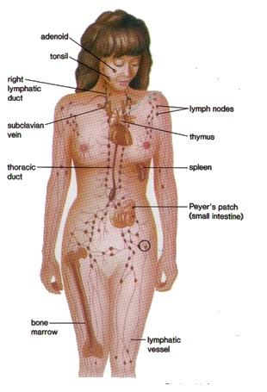
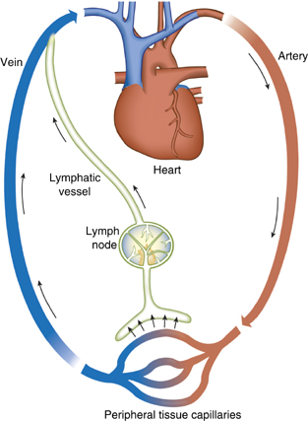
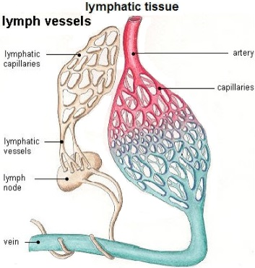
Lymphatic System

Slide 36
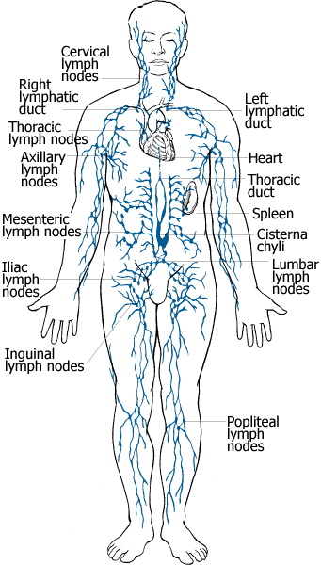
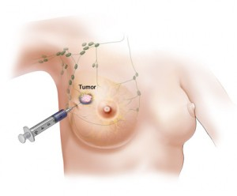
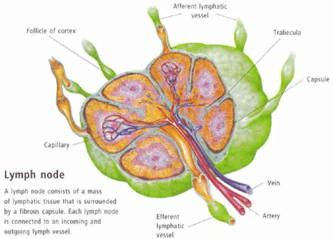
Lymph Nodes (Glands)
2 Functions:
Produce antibodies and lymphocytes
Filter lymph through phagocytosis
Macrocytes engulf and destroy old RBC’s and bacteria
Sentinel nodes
Like guardian or sentinel
Node closest to tumor
Biopsy shows tumor spread

Slide 37
Lymphatic Words
Root Word | Definition
Immuno | Immune
Lympho | Lymph
Lymphato | Lymph Node
Diagnostics
Elisa: initial test for AIDS
Western Blot: confirming test for AIDS
Lymphangiogram: X-ray after injection of contrast media into hand or foot, for lymphoma
Sentinel Node Biopsy
Abbreviation | Definition
ARC | AIDS Related Complex
AIDS | Acquired Immunodeficiency Syndrome
CMV | Cytomegalovirus
EBV | Herpes-Type Virus
HIV | Human Immunodeficiency Virus
KS | Kaposi’s Sarcoma
SLE | Systemic Lupus Erythematosus
MS | Multiple Sclerosis
Treatments
Drug Therapy
Radiation
Surgery
Tonsillectomy
Splenectomy

Slide 38
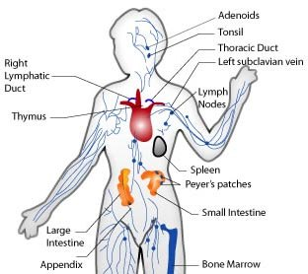
More Lymphatic Words
Immunization
Local reaction
Lymphadenopathy
Resistance
Susceptible
Immunosuppressive
Immunocompromised
Pathologies
AIDS
Cytomegalovirus
Hypersplenism: enlarged spleen
Kaposi’s Sarcoma: seen in AIDS
Lymphoma: lymph cancer
Mononucleosis
Myasthenia Gravis
Multiple Sclerosis
Pneumocystis Carinii Pneumonia
Sarcoidosis
Lymphedema
Lymphangioma

Slide 39

Gastrointestinal System

Slide 40

Gastrointestinal (or Digestive) System
Major Functions:
Break down food into nutrients
Supply nutrients to cells
Collect waste
Eliminate waste
Structure:
Basically, a long tube
Branches into organs
Divided into:
Upper GI tract
Lower GI tract

Slide 41



Mouth or Oral Cavity

Slide 42

Pharynx, Esophagus, Stomach
Pharynx: throat
Swallowing reflex
Esophagus: 10” long tube
Passes through diaphragm
Connects to stomach
Moves food along
Peristalsis: wave-like contractions
Rugae: gastric folds
Secrete HCL and digestive juices

Slide 43

Liver, Gallbladder, Biliary System
Liver: largest gland
Weighs 3-4 pounds
Secretes bile
Bile
Bilirubin: pigment
Emulsifies fats
Goes from liver to hepatic duct
To cystic duct
Into gallbladder
Stores bile, concentrates it
If fat in chyme, releases bile

Slide 44

Pancreas
Dual Role: both digestive and endocrine systems
Acinar Cells manufacture digestive juices
Duct Cells secrete sodium bicarbonate to neutralize acid
Pancreatic Duct
Joins common bile duct
Feeds into Duodenum

Slide 45

Lower Gastrintestinal Tract

Slide 46


Intestines, Rectum, Anus
Small Intestine
Completes digestion
Nutrients into blood
Wastes to large intestine
3 parts:
Duodenum, Jejunum, Ileum
Large Intestine
Cecum
Colon
4 Parts: Ascending, Transverse, Descending, Sigmoid
Rectum

Slide 47
Digestive System Words
Root Word | Definition
Appendo | Appendix
Bili, Chole | Bile
Colo, Colono | Colon
Ceco | Cecum
Laparo | Abdominal Wall
Esophago | Esophagus
Gastro | Stomach
Dento | Tooth
Linguo | Tongue
Odonto | Teeth
Spleno | Spleen
Lipo | Fat
Stomato | Mouth
Signs & Symptoms | Definitions
Anorexia | Loss of appetite
Aphagia | Loss of swallowing
Ascites | Large amount of fluid
Dyspepsia | Gastric discomfort
Emesis | Vomit
Eructation | Belching
Reflux | Backflow
Jaundice | Yellow discoloration
Pathology | Definition
Apthous Ulcer | Canker sore
Appendicitis | Inflammation of the appendix
Celiac Disease | Inability to digest gluten
Cirrhosis | Liver disease
Crohn’s Disease | Chronic inflammation of the digestive tract

Slide 48
More Digestive System Words
Abbreviation | Definition
Ba | Barium
BE | Barium Enema
GB | Gallbladder
GI | Gastrointestinal
GTT | Glucose Tolerance Test
HAV, HBV | Hepatitis A/B
LFT | Liver Function Test
N&V | Nausea and Vomiting
NG | Nasogastric
NPO | Nothing by Mouth
PP | Postprandial
TPN | Total Parenteral Nutrition
UGI, LGI | Upper/Lower Gastrointestinal
Pathology (cont’d) | Definition
Diverticular Disease | Outpouching or hernia in intestine
Dysentary | Bloody stools
Esophageal Varices | enlarged veins in the esophagus
Gallstones | Hardened deposits in the gallbladder
Hepatitis | Inflammation of the liver
Hiatal Hernia | Stomach sticks up into the chest through opening in diaphragm
Hirschsprung’s Disease | Lack of nerve cells in colon at birth, causing poor or nonexistent peristalsis
Irritable Bowel Syndrome | Spastic colon
Pancreatitis | Inflammation of the pancreas
Caries | Dental cavities
Colorectal Polyps | Small clumps of cells on the colon lining
Thrush | Fungal infection of the mouth and throat
Intestinal Obstruction | Blockage of the intestine
Volvulus | Twisting of loops of intestine or stomach

Slide 49

Respiratory System

Slide 50
Respiratory System
Functions:
Warms and filters air
Transports O2 to cells
Removes CO2 from cells
Assists in speech
Maintains acid-base balance
Phases:
Ventilation (breathing)
External exchange
Internal exchange
Cellular exchange
Structures:
Series of cavities and spaces
Upper respiratory tract
Nose, mouth, pharynx, vocal cords, larynx, trachea
Lower respiratory tract
Bronchi, bronchioles, alveoli, lungs
Outside lungs:
Pleura, pleural space, diaphragm

Slide 51

Breathing

Slide 52


Respiratory Tracts

Slide 53


Nose and Pharynx

Slide 54



Larynx and Vocal Cords

Slide 55

Lungs

Slide 56

Trachea and Bronchi

Slide 57
Respiratory Words
Root Word | Definition
Alveol | Alveolus
Broncho, Broncio | Bronchus
Epiglott | Epiglottis
Laryngo | Larynx
Naso, Rhino | Nose
Pharyngo | Pharynx
Pleuro | Pleura
Pneo | Breathing
Pneumo | Lungs, Air
Pulmono | Lungs
Sinus | Sinus
Thoraco | Throrax, Chest
Tracheo | Trachea
Abbreviation | Definition
ABG | Arterial Blood Gas
ARD (S) | Acute Respiratory Distress Syndrome
ARF | Acute Respiratory Failure
COPD | Chronic Obstructive Pulmonary Disease
CPR | Cardiopulmonary Resuscitation
CXR | Chest X-Ray
PCP | Pneumocystis Carinii Pneumonia
PFT | Pulmonary Function Test
RR | Respiration Rate
RDS | Respiratory Distress Syndrome
TST | Tuberculin Skin Test
URI | Upper Respiratory Tract Infection

Slide 58


More Respiratory Words
Pathologies
Asthma
Bronchitis
Coryzea, Rhinitis
Croup
Diptheria
Emphysema
Influenza
Laryngitis
Pertussis
Pleurisy
Pharyngitis
Pneumothorax
Pulmonary Embolism
SIDS
Sinusitis
Tonsilitis
Signs & Symptoms
Apnea
Common Cold
Cough
Cyanosis
Dysphonia
Hemoptysis
Hypoxemia
Hypoxia
Rales
Rhinnorhea
Sneeze
Stridor
Wheeze
Whooping Cough

Slide 59

Nervous System

Slide 60


Nervous System

Slide 61

Meninges
Covers brain
Covers spinal cord
Has 3 layers
Dura Mater
Arachnoid
Pia Mater

Slide 62


Brain

Slide 63


Spinal Cord and Spinal Nerves

Slide 64


Nervous System Functions

Slide 65



Neurons (Nerves Cells)

Slide 66
Nervous System Words
Root Word | Definition
Cerebello | Cerebellum
Cerebro | Cerebrum
Cortico | Cerebral Cortex (outer)
Encephalo | Brain
Medullo | Medulla Oblongata
Meningio | Meninges
Myelo | Spinal Cord (also bone marrow)
Narco | Unconsciousness, Stupor
Neuro | Nervous System
Somno | Sleep
Psycho | Mind
Thalamo | Thalamus
Ventriculo | Cavity, Ventrical
Define
Neurolysis
Meningioma
Myelodysplasia
Narcotic Drug
Psychoactive Drug
Meningococci
Neuralgia
Insomnia
Encephalopathy
Psychology
Psychiatry

Slide 67
More Nervous System Words
Pathologies | Definition
Cerebral Hypoxia | Lack of O2 in brain
Aneurysm | Ballooning, can burst
Aphasia | Loss of speech
Hemiplagia | Paralysis on one side
Hematoma | Epidural, subdural, intercranial: puts pressure on brain
Cerebral Contusion | Brain Bruise
Meningitis | Inflammation of brain and spinal cord membranes
Encephalitis | Inflammation of the brain
Shingles | Varicella-zoster, nerve infection
Neoplasms | Gliomas, astrocytoma
Tremor | Shaking
Parkinsonism | Movement abnormalities
Pathologies | Definition
Alzheimer’s Disease | Progressive, degenerative type of dementia
Dementia | Irreversible memory loss
Epilepsy | Seizure disorder
Insomnia, Narcolepsy, Sleep Apnea | Sleep disorders
Bipolar Disorder | Associated with mood swings
Depression | Persistent feeling of sadness, loss of interest
Mania | Characterized by euphoria, delusions, overactivity
Schizophrenia | Abnormal interpretation of reality
Psychosis | Disconnection from reality
Autism | Impaired communication and social interaction
Concussion | Result of a blow
Convulsion | Seizure
Hydrocephalus | Build-up of fluid in brain cavity

Slide 68
More Nervous System Words
Abbrev. | Definition
AD | Alzheimer’s Disease
ADHD | Attention-deficit/hyperactivity Disorder
ALS | Amyotrophic Lateral Sclerosis
ANS | Autonomic Nervous System
CP | Cerebral Palsy
CSF | Cerebrospinal Fluid
CVA | Cerebrovascular Accident
DSM | Diagnostic & Statistic Manual of Mental Disorders
EEG | Electroencephalogram
GAD | Generalized Anxiety Disorder
ICP | Intracranial Pressure
LP | Lumbar Puncture
MS | Multiple Sclerosis
OCD | Obsessive-Compulsive Disorder
PTSD | Post-Traumatic Stress Disorder
REM | Rapid Eye Movement
TIA | Transient Ischemic Attack
Drugs
Antianxiety Agents
Antidepressants
MAOIs: Monamin Oxidase Inhibitors, break down serotonin & norepinephrine
Neuroleptics: treat psychosis
SSRI: selective serotonin reuptake inhibitors (Prozac, Paxil)
Stimulants: promote activity, well-being
TCAs: Tricylclic antidepressants (Elavil)

Slide 69

Sensory System

Slide 70

Sensory System
5 senses:
Vision
Hearing
Smell
Touch
Taste
General sense organs:
Receptors throughout body
Specialized sense organs:
Receptors only in one area

Slide 71


Vision

Slide 72


Hearing

Slide 73

Sense of Smell
Stimulates appetite
Warn of toxins
Olfaction:
Sensory neurons in nasal canal
Through the olfactory bulb
Odors come from chemical reactions
Called odorants

Slide 74


Sense of Taste
10,000 taste buds
Roof of mouth, tongue
Girls have more than boys
Lose taste buds with age
Saliva breaks down food
Signals taste cells to send message to brain
Bumps on tongue are papillae
Amount of taste buds in papillae varies

Slide 75


Touch and Pressure

Slide 76


Sensory System Words
Vision Vocabulary | Definition
Astigmatism | Refractive Error
Blepharitis | Eyelid Inflammation
Monochromatism | Color Blindness
Cataract | Clouded Lens
Conjunctivitis | Pinkeye
Diabetic Retinopathy | Scarring
Glaucoma | Intraocular Pressure
Hordeolum | Stye, infection of the eyelash follicle
Macular Degeneration | Causes vision loss, often age-related
Retinal Detachment | Emergency: retina pulls away from supportive tissue
Slit-Lamp Exam | Looks at structures at the front of the eye
Strabismus | Eyes not working together (crosseye, walleye)
Ear Vocabulary | Definition
Audiometry | Measures hearing with a variety of sounds
Deafness | Significant loss of hearing; may use aids
Otitis Externa | Swimmer’s ear
Otitis Media | Middle Ear infection, common in children
Perforated Eardrum | Hole in the eardrum, can be repaired
Meniere’s Disease | Chronic inner ear infection
Myringotomy | Inserting a tube into the ear drum
Impacted Cerumen | Earwax buildup
Weber Rinne Test | Tuning fork

Slide 77



Urinary System

Slide 78

Urinary System and Body Fluids
Upper Urinary Tract:
Kidneys
Functions:
Filter the blood
Remove waste products
Maintain water & electrolyte balance
Produces urine
Lower Urinary Tract:
Pelvicalyceal system: collects urine
Ureters: transport urine
Bladder: stores urine
Urethra: voids urine

Slide 79

Kidneys

Slide 80


Nephron with Glomerulus

Slide 81

Glomerulus (Bowman’s capsule)

Slide 82




Ureters and Bladder

Slide 83


Urethra and Sphincters

Slide 84

Urinary System Words
Root Word | Definition
Cali, Calic | Calyx
Glomerulo | Glomerulus
Litho | Stone
Nephro, Reno | Kidney
Pyelo | Renal Pelvis
Pyo | Pus
Vesico | Urinary Bladder
Abbreviation | Definition
ADH | Antidiuretic Hormone
AGN | Acute Glomerular Nephritis
ARF | Acute Renal Failure
BUN | Blood Urea Nitrogen
CRF | Chronic Renal Failure
Cysto | Chystoscopy
ESRD | End-Stage Renal Disease
ESWL | Extracorporeal Shock-Wave Lithotripsy
RP | Retrograde Pyelogram
UA | Urinalysis

Slide 85



More Urinary Tract System Words
Diagnosis/Treatment | Definition
Cytoscopy | Viewing the interior of the bladder with cystoscope
Intravenous Pyelogram | Inject contrast dye to view its passage through entire urinary tract
Renal Scan | Like bone scan, is a nuclear test. Inject a radioactive tracer which concentrates in kidney and diminishes as it leaves.
Urinalysis | Physical, chemical, microscopic urine exam.
Urine Culture | Allow bacteria to grow in urine
Peritoneal Dialysis | Removal of waste products from blood using a machine when kidneys cannot

Slide 86

Endocrine Gland System

Slide 87

Endocrine System
Functions:
Secrete hormones
Regulate body functions
Growth, metabolism
Reproduction, behavior
Bind with receptors

Slide 88

Pineal, Hypothalamus, Pituitary
Pineal Gland: produces melatonin. Regulates the sleep-wake cycle. Biological clock.
Hypothalamus: produces Releasing Hormones (RH). Stimulates pituitary.
Infundibulum: transports RH to pituitary.
Pituitary: “Master Gland”
2 lobes:
Anterior (6 hormones) and Posterior (2 hormones).

Slide 89
Pituitary Hormones (8)
GH: growth hormone, stimulates growth of body tissues and helps handle nutrients and minerals
LH: luteinizing hormone, triggers ovulation and stimulates testosterone production
PRL: prolactin, activates milk production in breastfeeding women
TSH: thyrotropin, stimulates the thyroid to produce hormones that stimulate metabolism
FSH: follicle stimulating hormone, regulates puberty
Oxytocin: contracts uterus during childbirth, causes milk ejection, also emotional effects impacting social behaviors
ADH: antidiuretic hormone, retains water and constricts blood vessels
ACTH: corticotropin, stimulates adrenal cortex to produce cortisol. Aids in Stress and pain management

Slide 90

Thyroid and Parathyroids
Thyroid (3 hormones)
T3: tri/iodo/thi/ro/nene.
T4: thyroxine
Work together with iodine, control metabolism
Calcitonin: decreases calcium level in blood
Parathyroid (1 hormone)
PTH: parathyroid hormone, increases calcium in blood

Slide 91
Pancreas
Beta Cells:
Secrete insulin
Decreases blood glucose level
Delta cells:
Secrete somatostatin
Inhibits release of insulin and glucagon
Alpha Cells:
Secrete glucagon
Increases blood glucose levels
Pancreatic Islets:
Alpha Cells
Beta Cells
Delta Cells
Affect liver, blood, and the storage and use of fat and carbohydrates

Slide 92

Adrenal Glands
Adrenals composed of:
Medulla
Adrenal Cortex
Medulla:
Vital for life; maintains sympathetic nervous system
Secretes catecholemines:
Epinephrene (Adrenaline)
Norepinephrene

Slide 93
Adrenal Cortex
Produces corticosteroid hormones:
Glucocorticoids:
Cortisol: hydrocortisone
Corticosterone
Mineralcorticoids:
Also called electrolytes
Regulate sodium and potassium
Aldosterone: main hormone
Sex hormones:
Small amounts of estrogen and androgens

Slide 94

Endocrine System Words
Root | Definition
Adeno | Adrenal Glands
Corti | Cortex
Crino | Secrete
Dipso | Thirst
Gonado | Sex Glands
Gluco, Glyco | Sugar, Sweet
Kali | Potassium
Lacto | Milk
Thyro, Tyroido | Thyroid
Toxico | Poisons
Pituitary Pathologies | Definition
Acromegaly | Enlargement and elongation of bones in face, jaw, and extremities; oversecretion of growth hormone after puberty
Dwarfism | Growth retardation, not enough growth hormone
Gigantism | Overgrowth of whole body
Diabetes Insipidus | Rare; lack of antidiuretic hormone, causes excessive thirst, urine output, and sodium excretion
Thyroid Pathologies | Definition
Goiter | Enlarged thyroid gland, lack of iodine
Grave’s Disease | Excessive secretion of thyroid hormones (hyperthyroidism). Speeds up metabolism, causes bulging eyes.
Hypothyroidism | Shortage of thyroid hormones, sluggish metabolism
Thyrotoxicosis | Thyroid storm; acute, sometimes fatal overproduction of thyroid hormones. Fever, delirium, high pulse rate.
Parathyroid Pathologies | Definition
Hyperparathyroidism | Overactivity of parathyroids, causes high blood calcium
Hypoparathyroidism | Underactivity of parathyroids, low blood calcium, muscle weakness, spasms.

Slide 95


Endocrine System Words
Adrenal Pathologies | Definition
Addison’s Disease | Life-threatening, failure of adrenal cortex to secrete hormones
Cushing’s Syndrome | Excessive amount of cortisol in blood, caused by tumor, central obesity and “moon face” signs
Pheocytochromatosis | Vascular tumor of adrenal medulla; flushing, sweating, hypertension, palpitations signs
Virilism | Development of male sex characteristics in the female
Abbreviations | Definition
BMR | Basal Metabolic Rate
DI | Diabetes Insipidus
DKA | Diabetic Ketoacidosis
DM | Diabetes Mellitis
FBS | Fasting Blood Sugar
GTT | Glucose Tolerance Test
HgA1C | Hemoglobin A1C
IDDM | Insulin Dependent
NIDDM | Non-insulin Dependent
RAI | Radioactive Iodine
T3, T4 | Thyroid Hormones
TFT | Thyroid Function Test
Pancreatic Pathologies | Definition
Diabetes Mellitus | Hyperglycemia, excessive thirst, increased eating, yet weight loss. Epidemic – 8-10% of US. Type 1 needs insulin, 2 can have oral meds.
Diabetic Retinopathy | Disorders of retinal vessels after 8-10 years of diabetes.
Gestational Diabetes | Develops during latter part of pregnancy
Pancreatitis | Acute or chronic obstructive inflammation of pancreas, caused by alcohol abuse, malnutrition, or surgery
Diabetic Ketoacidosis | Blood sugar too high. If body cannot use glucose for energy, it will break down fats and proteins instead and produce ketones, which spill into urine. Leads to coma and death.

Slide 96

Reproductive System

Slide 97


Female Reproductive System

Slide 98


Ovaries, female reproduction

Slide 99


Female Reproductive Words
Root | Definition
Cervico | Neck, Cervix
Colpo, Vagino | Vagina
Gyneco | Woman
Hystero, Metrio | Uterus
Mammo, Masto | Breast
Meno | Menstruation
Utero | Uterus
Birth Control Methods
Drugs
Barriers
Intrauterine device
Tubal ligation
Abbreviation | Definition
AB | Abortion
CIS | Carcinoma in Situ
Cx | Cervix
D&C | Dilation & Curretage
ERT | Estrogen Replacement Therapy
IUD | Intrauterine Device
PAP | Papanicolau Smear

Slide 100


Male Reproduction System

Slide 101



Testes, Prostate, Sperm

Slide 102


Male Reproductive Words
Root | Definition
Balano | Glans Penis
Orcho, Orchido | Testicle
Prostato | Prostate
Spermato | Sperm
Testo | Testicle(s)
Abbreviation | Definition
BPH | Benign Prostatic Hypertrophy
FTA-ABS | Blood Test for Syphilis
GC | Gonorrhea, Gonococcus
PSA | Prostate-Specific Antigen
TSE | Testicular Self-Examination
TUR(P) | Transurethral Resection of the Prostate Gland

Slide 103


Fertilization

Slide 104

Conception to Implantation

Slide 105

Embryo to Fetus

Slide 106



Pregnancy and Birth

Slide 107

Immune System

Slide 108
Immune System Function
Protect from pathogens
Immune response:
Triggered by invading antigens
B-lymphocytes produce antibodies
Antibodies are blood proteins
Immunoglobulins – IgG
Migrate to site of infection
Destroy antigen
T-lymphocyctes circulate in blood
Autoimmune disorders
Hypersensitivity
Overresponse to allergen
Anaphylactic shock

Slide 109

Integumentary System

Slide 110
Integumentary System
Skin and its appendages, hair, nails, glands
Largest body system
15% of body weight
3 layers:
Epidermis,
Dermis,
Hypodermis, subcutaneous fat
Protect from bacteria and viruses, toxins
Protects from sun’s ultraviolet rays, melanin provides color
Sense the outside world: acts a sensory receptor
Regulates the body temperature
Eliminates bodily wastes through perspiration
After sun exposure, synthesizes chemical for Vitamin D production

Slide 111

Skin Structure

Slide 112
Skin Words –Roots & Abbrev.
Root | Definition
Adipo, Lipo | Fat
Albin | White
Cauto | Burn
Cutaneo | Skin
Dermo, Demato | Skin
Erythro | Red
Hidro | Sweat
Histo | Tissue
Kerato | Hard, Horn-like
Myco | Fungus
Onycho | Nails
Pilo, Tricho | Hair
Sclero | Hard
Xantho | Yellow
Xero | Dry
Abbreviation | Definition
Bx | Biopsy
Decub. | Decubitus Ulcer
Derm. | Dermatology
FS | Frozen Section
I&D | Incision & Drainage
LE, SLE | Systemic Lupus Erythematosus
Subq. | Subcutaneous
TENS | Transcutaneous Electrical Nerve Stimulation
Ung. | Ointment
UV | Ultraviolet
XP | Xeroderma Pigmentosum

Slide 113
Common Skin Words
Lesion Word | Definition
Lesion | Area of Injury
Abrasion | Scrape
Abscess | Collection of Pus
Fissure | Crack in Skin
Cyst | Sac, Pouch of Fluid
Laceration | Tear in Skin
Polyp | Stalk-like Growth
Ulcer | Open Sore
Wheal | Raised Lesion, itch (hives, bites)
Blister | Lesion with fluid
Bulla | Big Blister
Comedo | Pimple
Pustule | Small Abscess
Scales | Thin Flakes
Xero | Dry
Pathologies
Acne | Albinism
Callus | Carcinoma
Dermatitis | Ecchymosis
Eczema | Gangrene
Hyperhidrosis | Hyperkeratosis
Impetigo | Jock Itch
Kaposi’s | Keloid
Lupus | Melanoma – ABCD
Nevus (mole) | Pediculosis
Psoriasis | Pruritus
Rosacea | Scabies
Scleroderma | Shingles
Tinea | Wart

